Slide 1
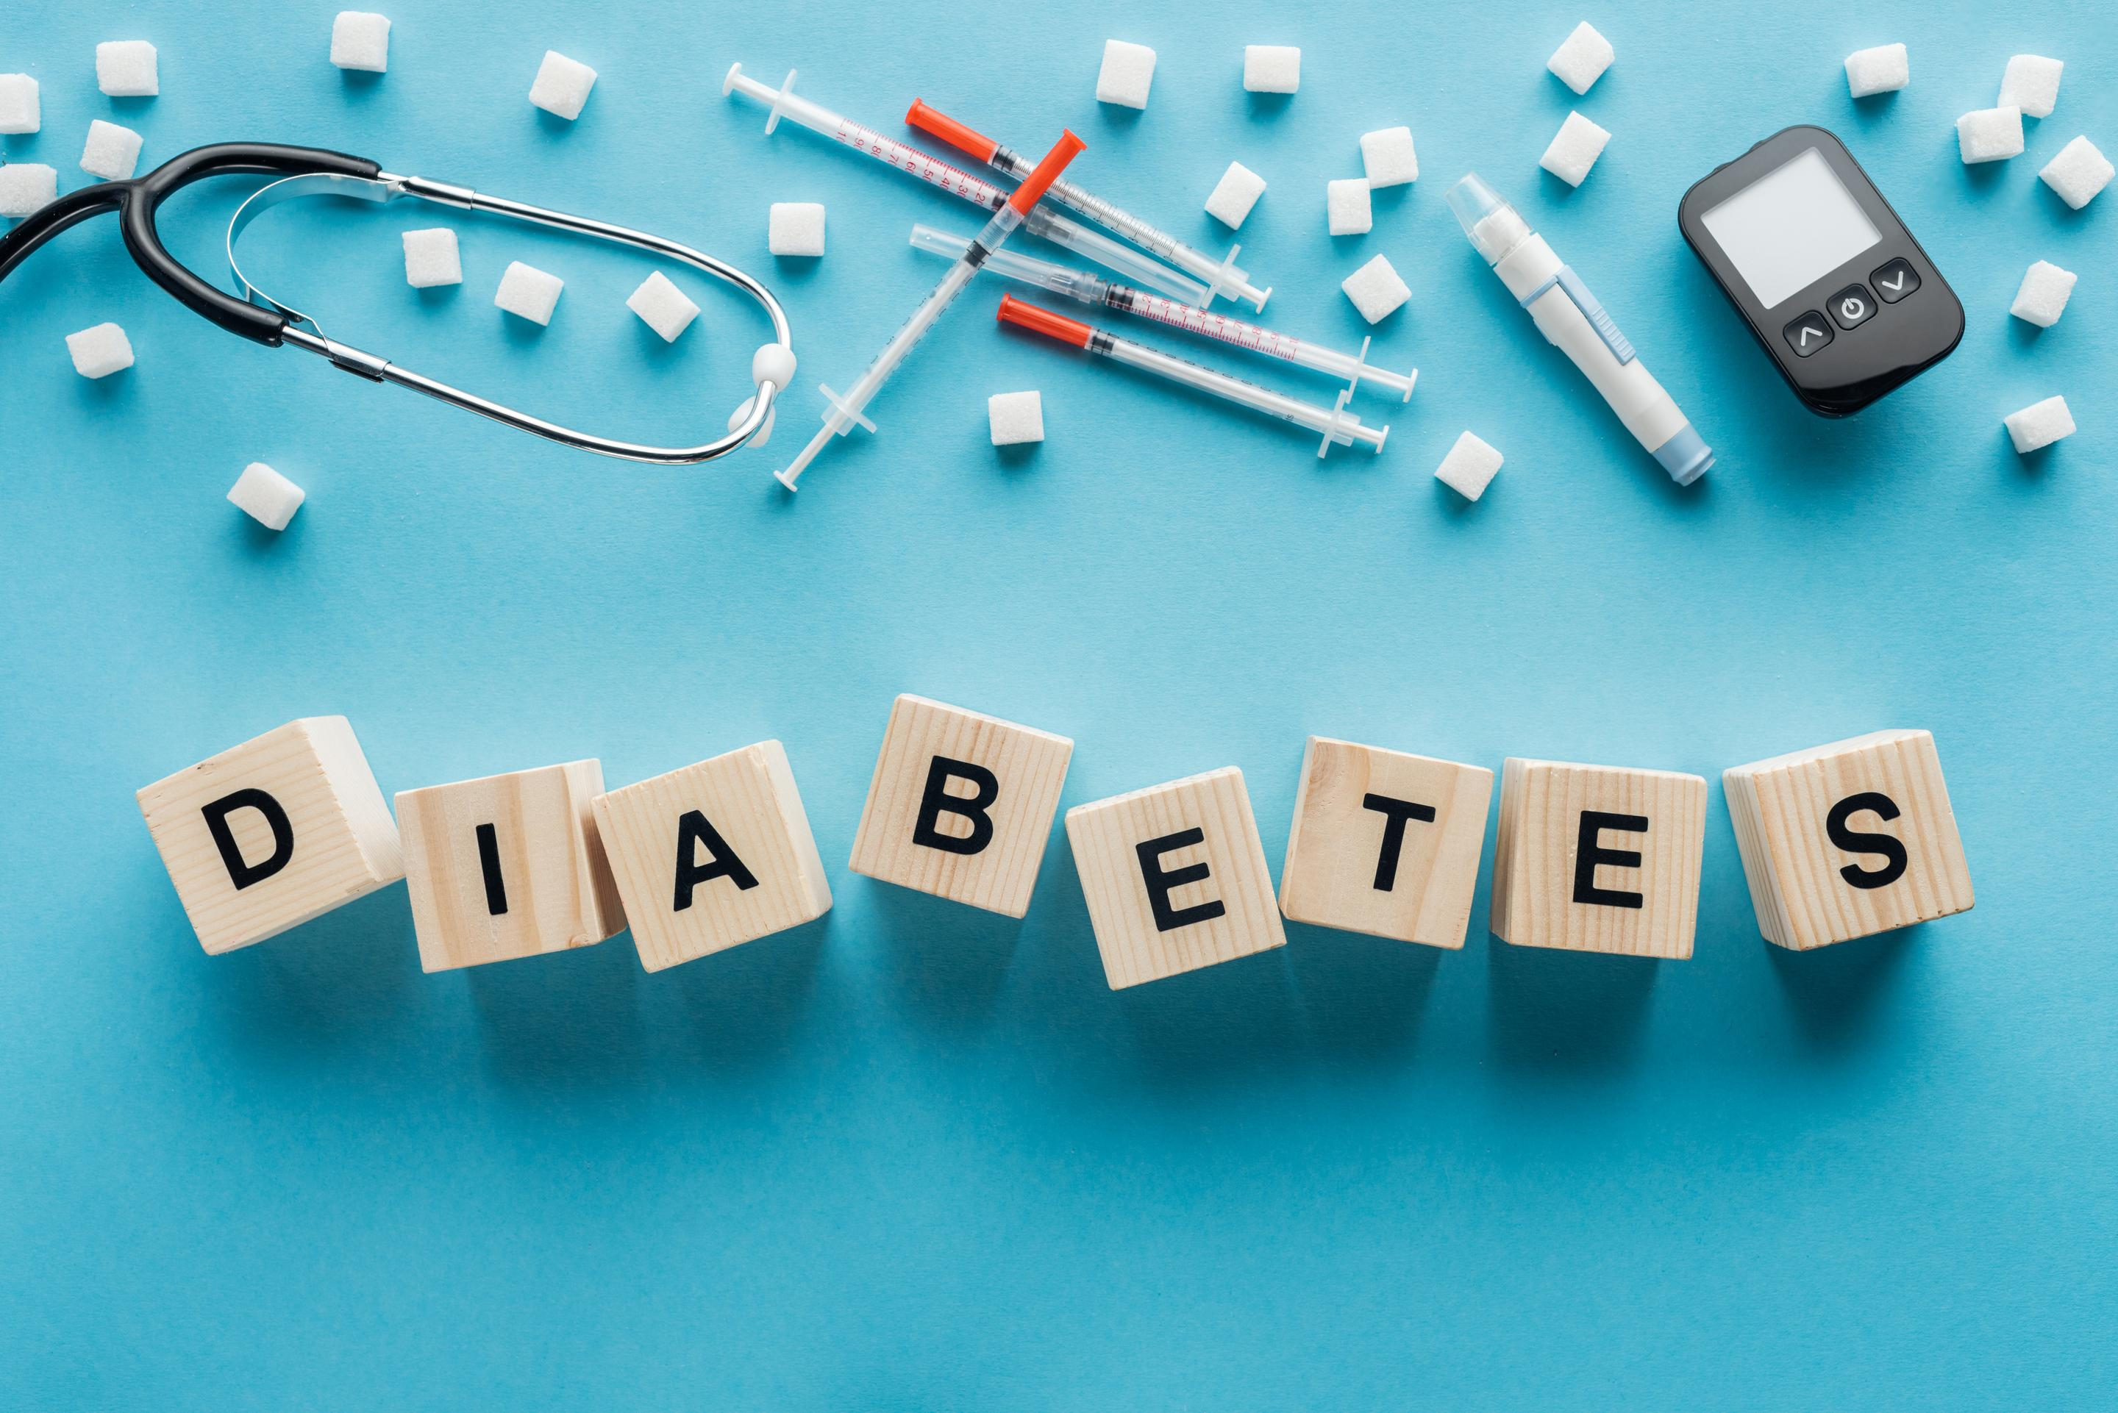


Slide 2
Objective
Diabetes is a complex disease that is influenced by both genetic and environmental factors. Agenda is to investigate the dataset and create a prediction model to estimate diabetes outcomes in the people. among this section, we will look at several elements of diabetes by doing exploratory data analysis and predictive analysis to forecast the outcome on the basis of input characteristics.

Slide 3
Data Dictionary
The dataset has the following information:
Pregnancies: Number of times pregnant.
Glucose: Plasma glucose concentration over 2 hours in an oral glucose tolerance test.
BloodPressure: Diastolic blood pressure (mm Hg)
SkinThickness: Triceps skin fold thickness (mm)
Insulin: 2-Hour serum insulin (mu U/ml)
BMI: Body mass index (weight in kg/(height in m)^2)
DiabetesPedigreeFunction: A function that scores the likelihood of diabetes based on
family history.
Age: Age in years.
Outcome: Class variable (0: a person is not diabetic or 1: a person is diabetic).

Slide 4
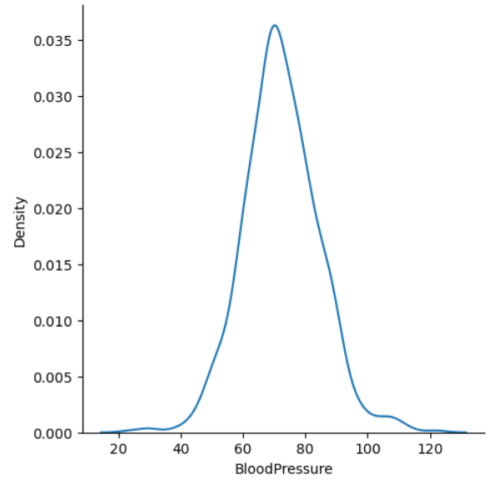
Data Exploration:
Visualization plays a crucial role in data exploration. The distribution plot using the displot() function from Seaborn was created to visualize the distribution of the 'BloodPressure' variable. The plot revealed that the majority of values were concentrated between 60- and 80-mm Hg.

Slide 5
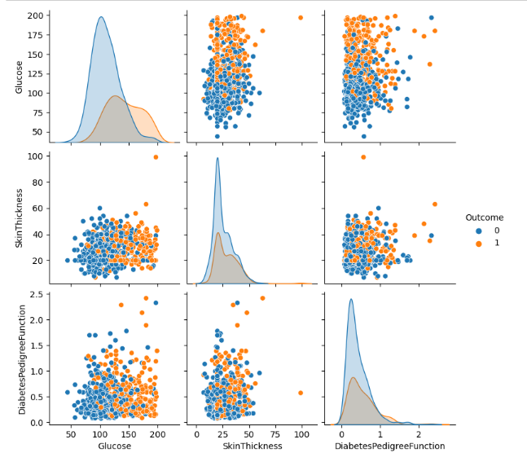
Cont…
To identify relationships between variables, a pairplot was generated using the pairplot() function from Seaborn. This plot displayed the relationships between 'Glucose', 'SkinThickness', and 'DiabetesPedigreeFunction', with the data points colored based on the 'Outcome' variable. The pairplot indicated that individuals with diabetes tended to have higher glucose levels.

Slide 6
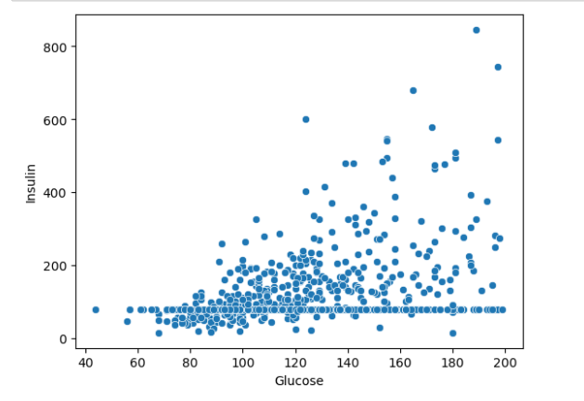
Cont..
Additionally, a scatterplot was created to explore the relationship between 'Glucose' and 'Insulin' using the scatterplot() function from Seaborn. The scatterplot showed that higher glucose levels were generally associated with higher insulin levels.

Slide 7
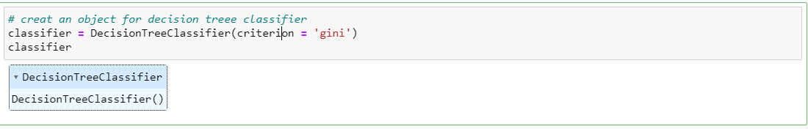
Predictive Modeling
A decision tree classifier was created using the DecisionTreeClassifier() function from scikit-learn. The criterion for splitting the nodes was set to 'gini', which measures the impurity of the split. The classifier was then fitted to the training data using the fit() function.

Slide 8
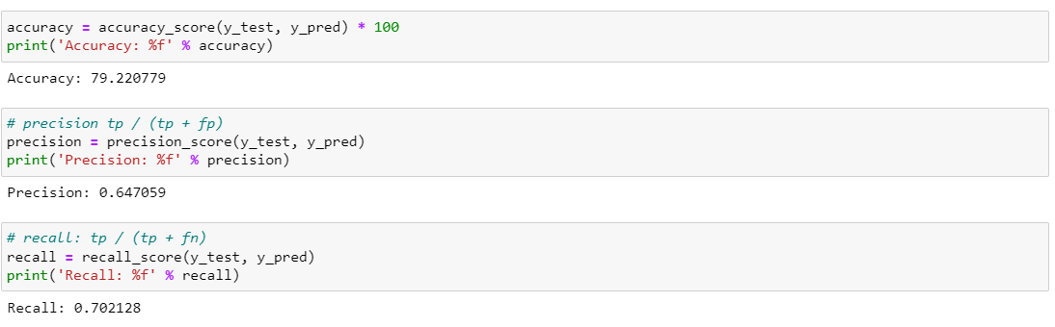
Cont…
Predictions were made on the testing set using the predict() function, and the accuracy, precision, and recall scores were calculated to evaluate the model's performance. The accuracy score represents the percentage of correct predictions, while the precision score measures the model's ability to correctly identify positive instances. The recall score calculates the proportion of actual positive instances correctly identified by the model.

Slide 9
Ethical & Professional Responsibilities
Keep Data Safe: Make sure you protect people's personal information and keep the data secure.
Avoid Bias: Try your best to be fair and avoid any unfairness in your predictions.
Explain Your Model: Try to make your model easy to understand so people can trust it.
Ask for Permission: Always ask for permission before using someone's data.
Be Careful with Predictions: Check if your predictions might cause any harm or be unfair to certain groups.
Check and Update Your Model: Keep an eye on your model's performance and update it regularly.

Slide 10
Conclusion
In conclusion, the study demonstrated the importance of data preparation, exploration, modeling, and evaluation in healthcare data analysis. The use of Python libraries such as NumPy, Pandas, Seaborn, and Matplotlib enabled efficient data exploration and modeling, and the findings provide valuable insights into the factors affecting diabetes. The study also highlights the potential of machine learning algorithms in developing predictive models for healthcare applications. Further research can expand on this work by exploring more advanced machine learning techniques and incorporating additional variables to improve model accuracy

Slide 11


